Slide 1


Slide 2
MUSIC RECOMMENDER SYSTEM
BATCH 16

Slide 3
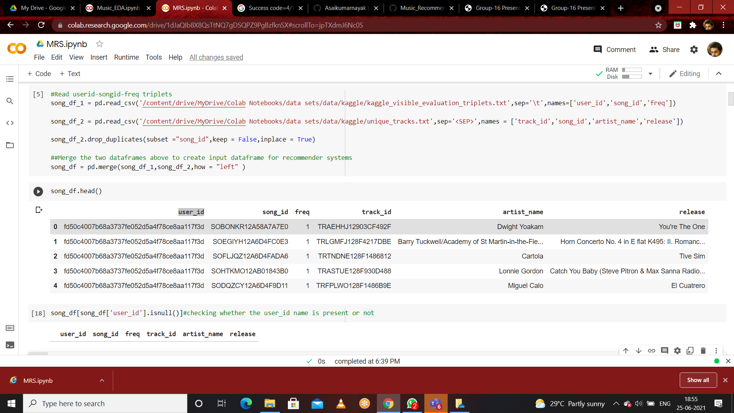

Slide 4
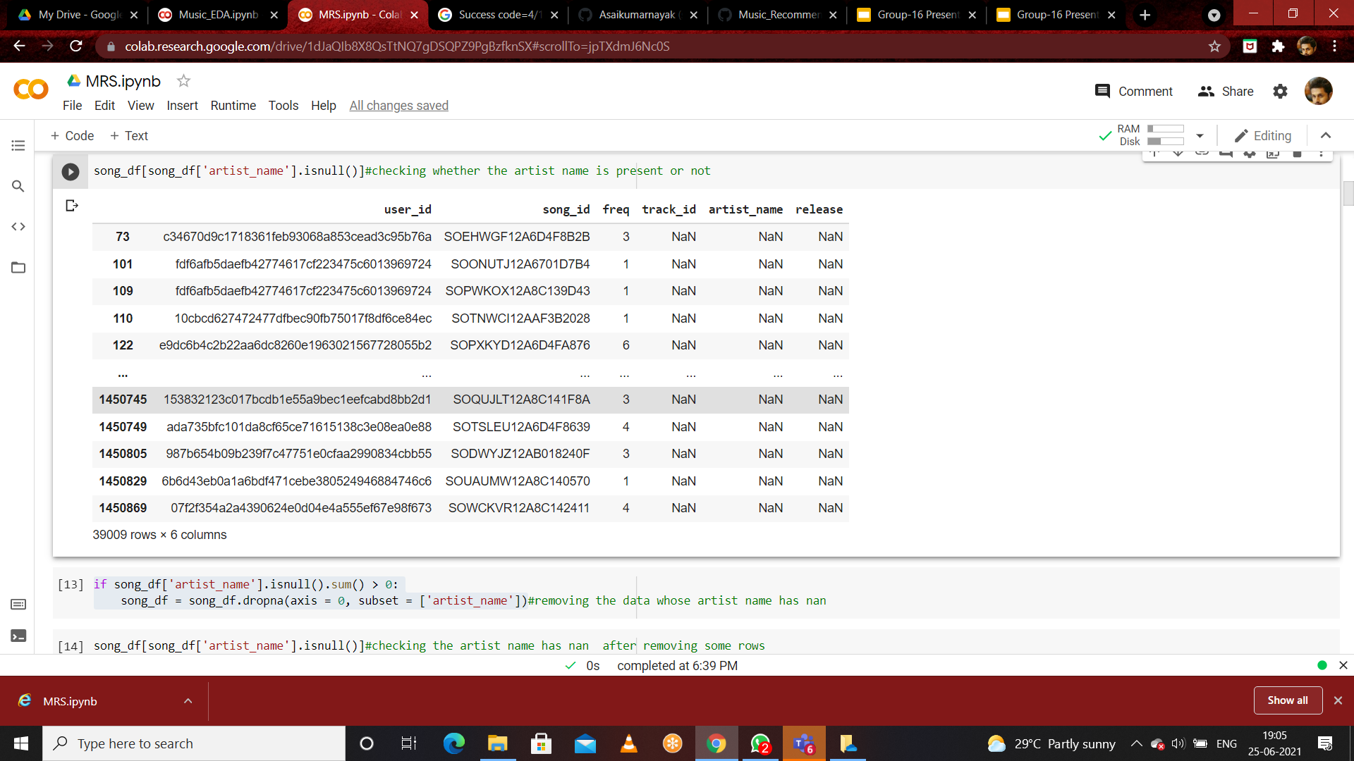

Slide 5
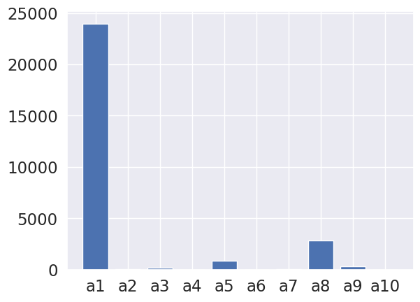
CLUSTERING ON ARTIST DATA

Slide 6
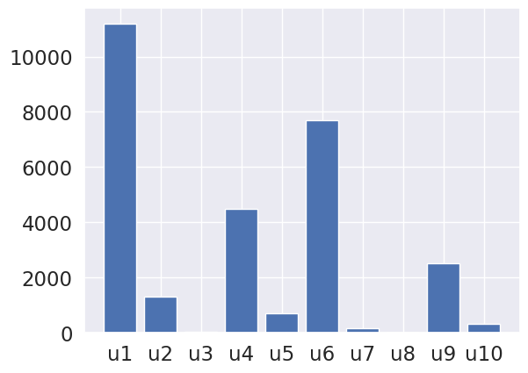
CLUSTERING ON USER DATA

Slide 7
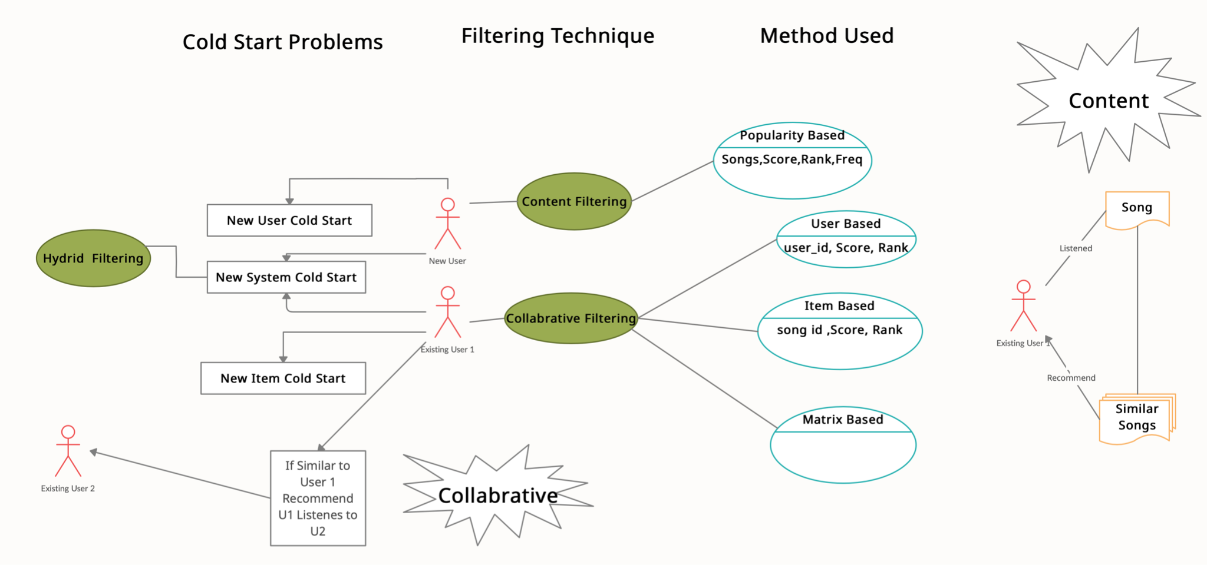

Slide 8
CONTENT BASED RECOMMENDATION

Slide 9
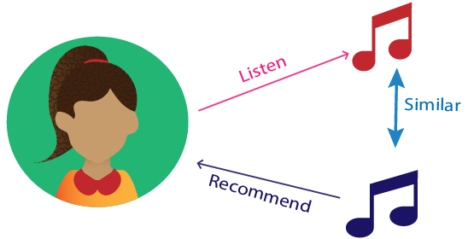
Content Based Recommendation
Approach : Keyword Matching
Content-based systems:
it will recommend anything similar to an item the user has liked/listen to before.

Slide 10
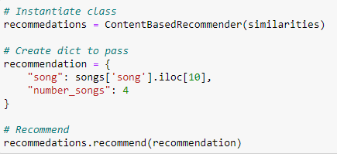
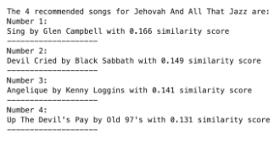
Content Based Recommendation
pick a song from the dataset
OUTPUT

Slide 11
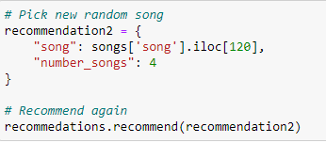
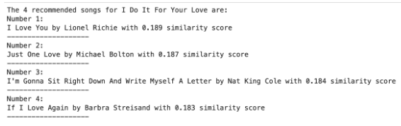
Content Based Recommendation
pick another random song and recommend again:
OUTPUT

Slide 12

POPULAR BASED
RECOMMENDER SYSTEMS( OLD SCHOOL METHOD)

Slide 13
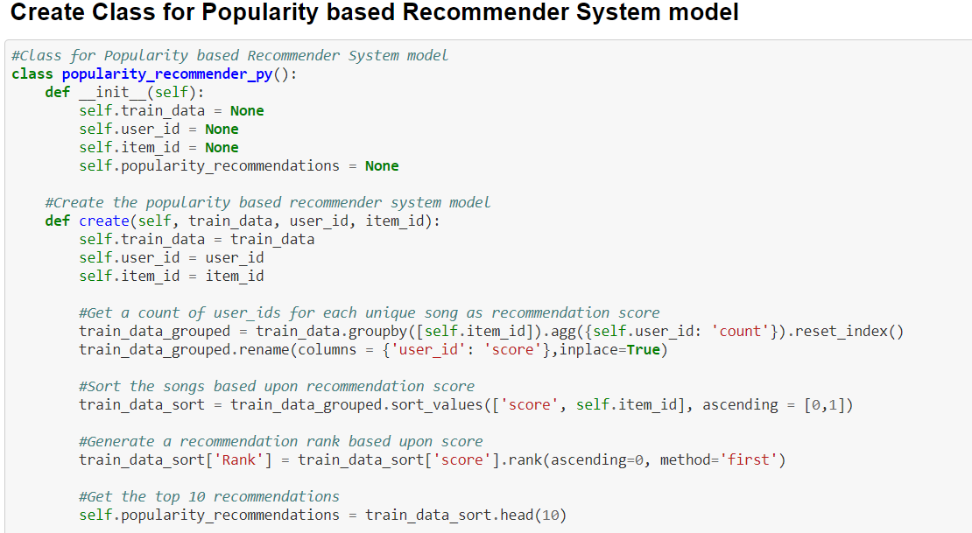

Slide 14
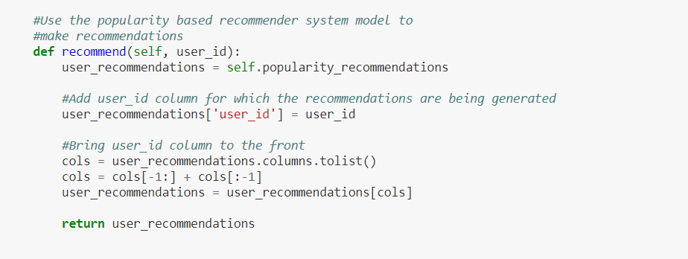

Slide 15
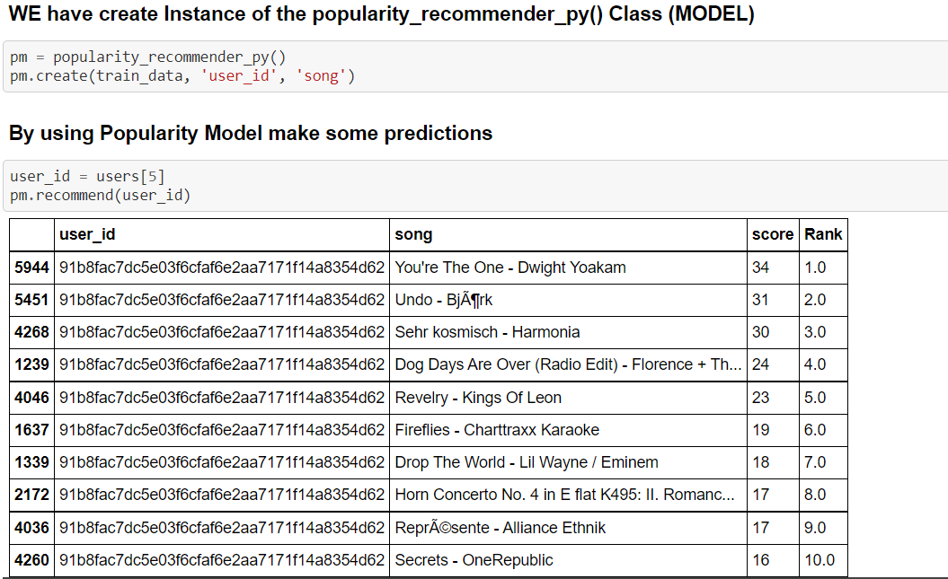

Slide 16
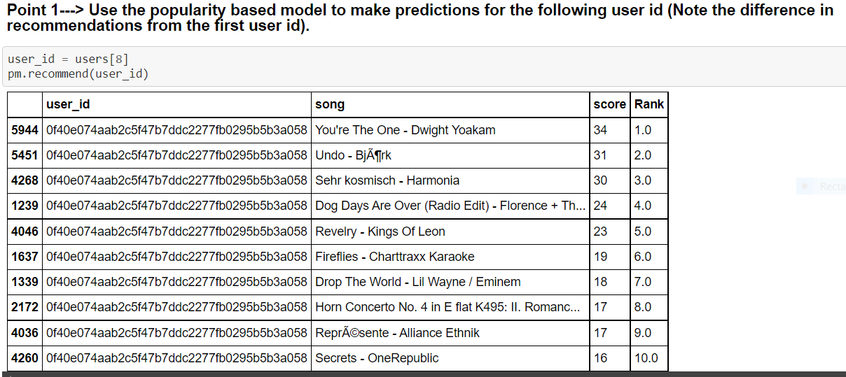

Slide 17
COLLABORATIVE FILTERING RECOMMENDER SYSTEMS

Slide 18
Approach :
User Based Collaborative Filtering
Item Based Collaborative Filtering

Slide 19
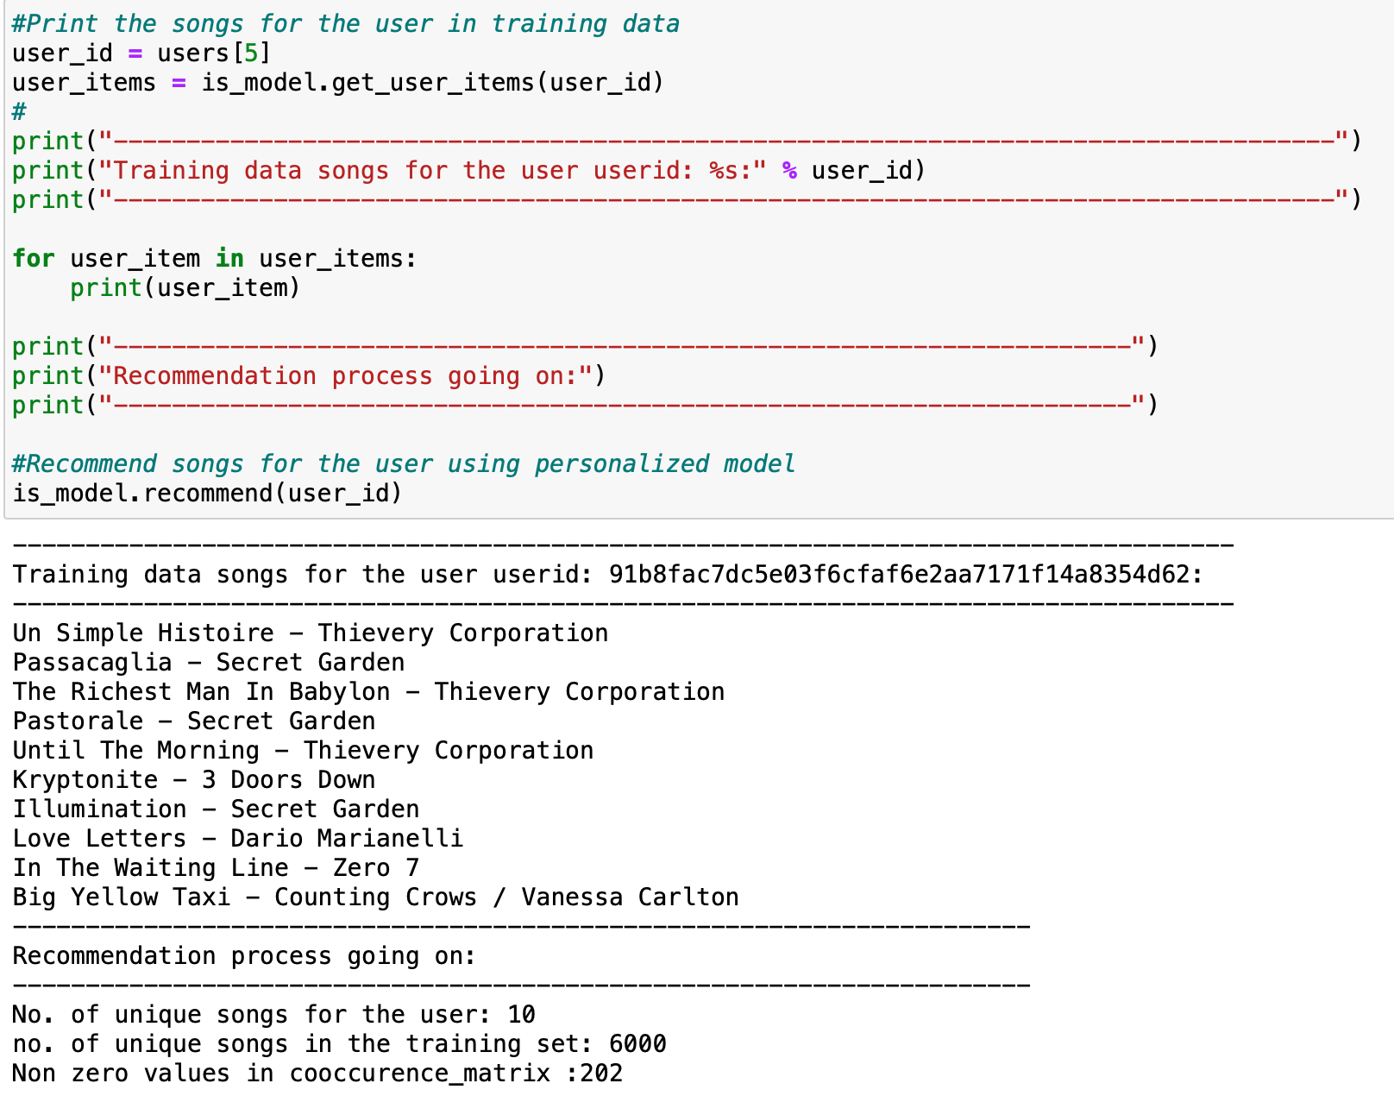

Slide 20
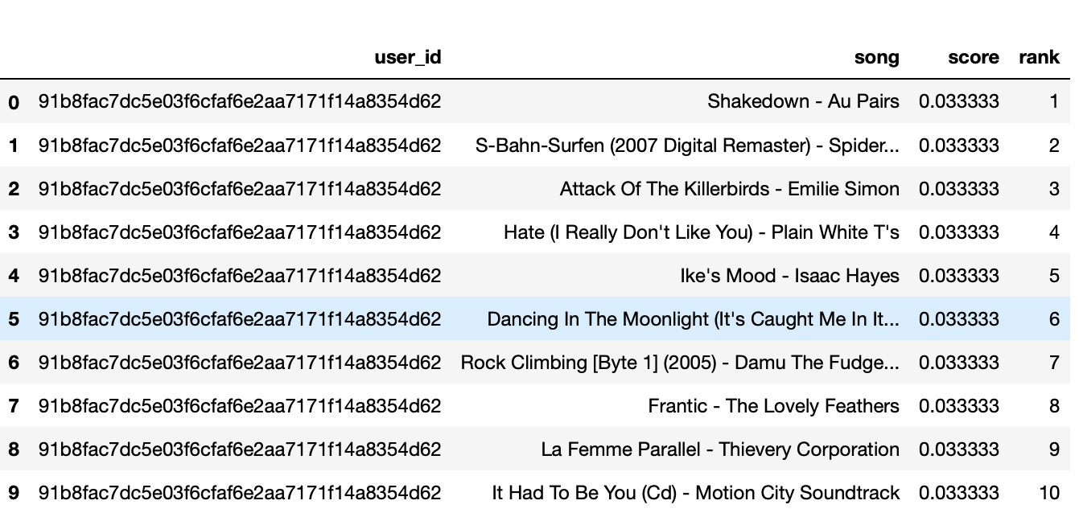

Slide 21
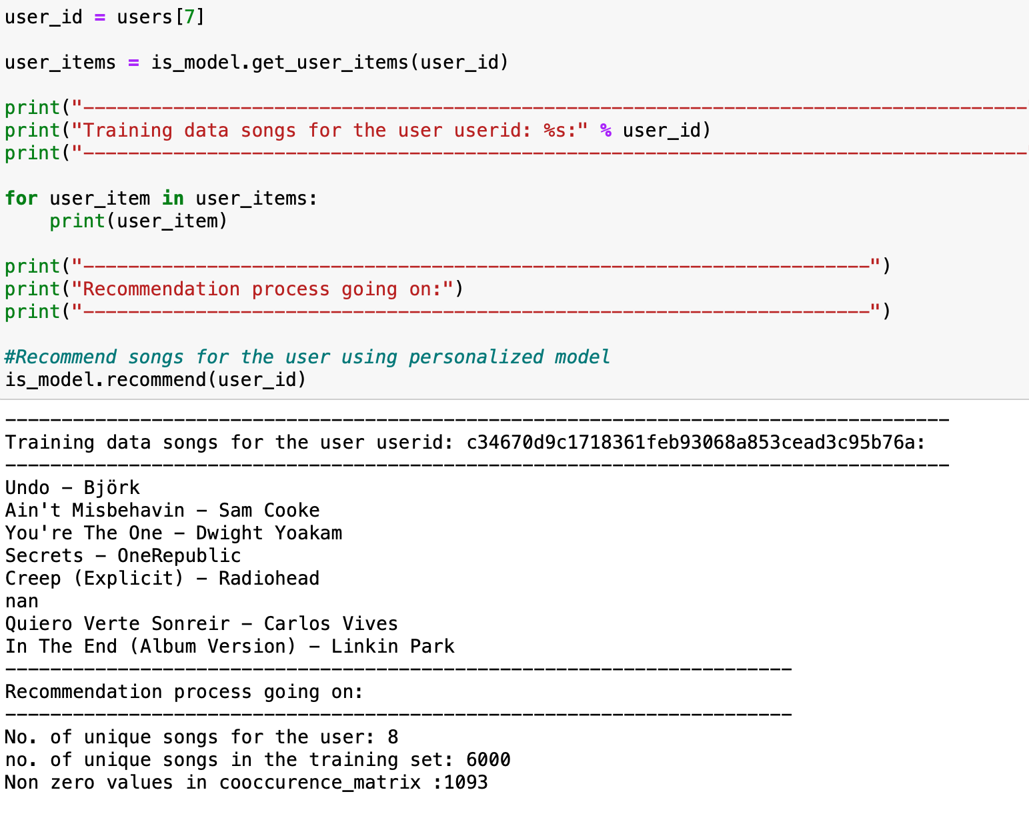

Slide 22
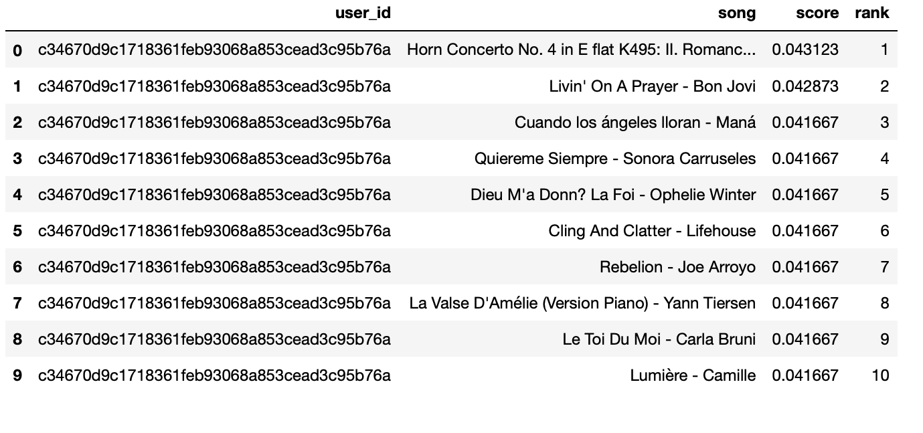

Slide 23
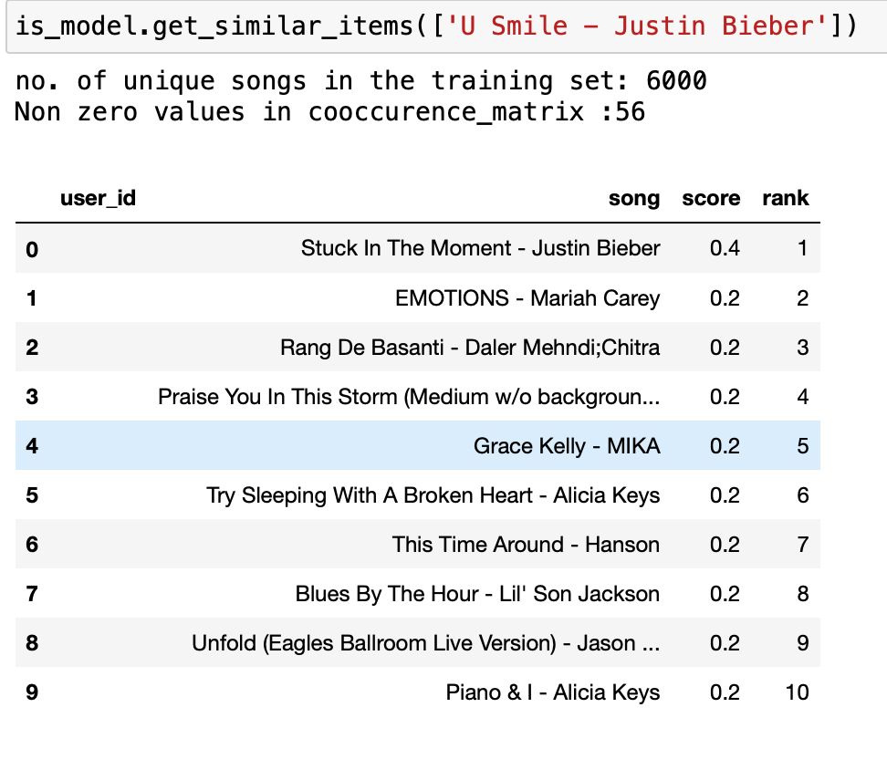

Slide 24
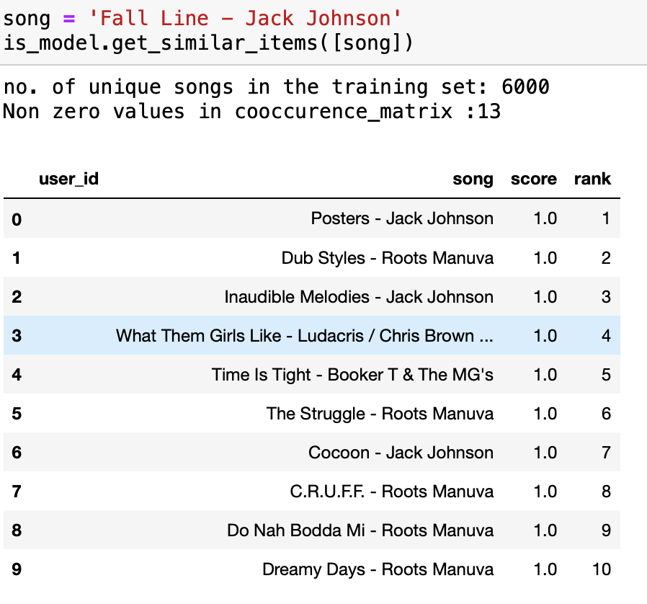

Slide 25
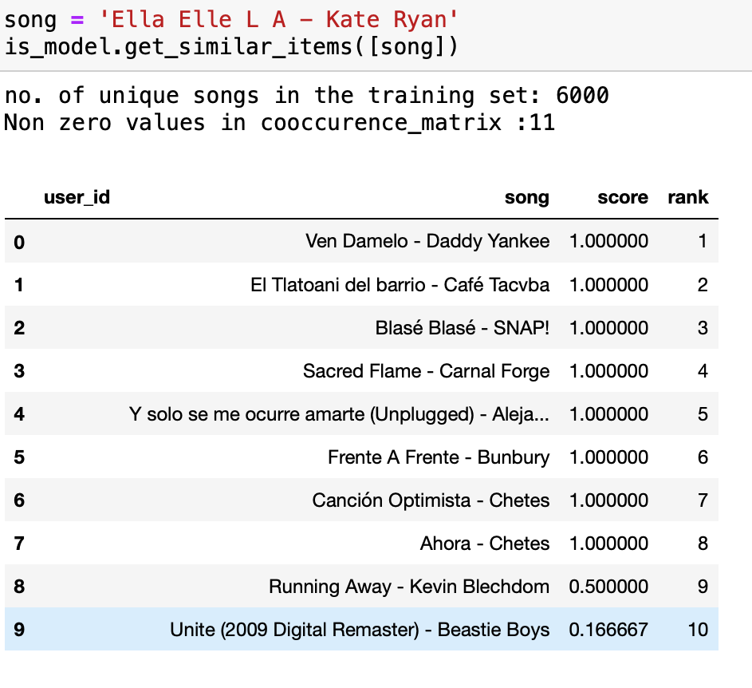

Slide 26

THANK YOU

